Slide 1
Java Collections Framework

Slide 2
The Collection Framework
A collections framework is a unified architecture for representing and manipulating collections. All collections frameworks contain the following:
Interfaces: These are abstract data types that represent collections. Interfaces allow collections to be manipulated independently of the details of their representation. In object-oriented languages, interfaces generally form a hierarchy.
Implementations, i.e., Classes: These are the concrete implementations of the collection interfaces. In essence, they are reusable data structures.
Algorithms: These are the methods that perform useful computations, such as searching and sorting, on objects that implement collection interfaces. The algorithms are said to be polymorphic: that is, the same method can be used on many different implementations of the appropriate collection interface.
There are two groups of interfaces in Collection framework:
1. Collection
2. Map

Slide 3
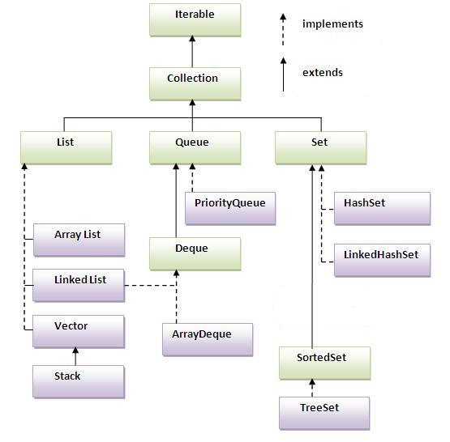
Collection Interface

Slide 4
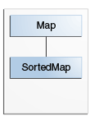
Map Interface

Slide 5
The Iterable Interface
The Iterable interface is one of the root interfaces of the Java collection classes. The Collection interface extends Iterable, so all subtypes of Collection also implement the Iterable interface.
Since the Iterable interface is being implemented so each element of a Collection class can be accessed using for...each construct. For example:
List countryList = new ArrayList();
for(String country : countriesList){
System.out.println(country);
}
Besides, you also have the option to iterate using Iterator as follows:
Iterator<String> iter = countriesList.iterator();
while(iter.hasNext()){
System.out.println(iter.next());
}

Slide 6
Iterator vs for..each
Use Iterator instead of the for-each construct when you need to:
Remove the current element. The for-each construct hides the iterator, so you cannot call remove. Therefore, the for-each construct is not usable for filtering.
Iterate over multiple collections in parallel.

Slide 7
Add/Remove elements
You can add an element to a Collection class by calling its "add" method, e.g:
List countryList = new ArrayList();
countryList.add("India");
countryList.add("UK");
In order to remove an element from a Collection class, you need to call the "remove" method, e.g:
countryList.remove("UK");

Slide 8
Checking if collection contains a particular element
The Collection interface has two methods to check if a Collection contains one or more certain elements. These are thecontains() and containsAll() methods.
countryList.contains("INDIA");
Check the size of a collection
You can also check the size of a collection, that is, how many elements it does contain using its "size" method:
int numberOfElements = countryList.size();

Slide 9
Collection Interface Bulk Operations
Bulk operations perform an operation on an entire Collection. You could implement these shorthand operations using the basic operations, though in most cases such implementations would be less efficient. The following are the bulk operations:
containsAll — returns true if the target Collection contains all of the elements in the specified Collection.
addAll — adds all of the elements in the specified Collection to the target Collection.
removeAll — removes from the target Collection all of its elements that are also contained in the specified Collection.
retainAll — removes from the target Collection all its elements that are not also contained in the specified Collection. That is, it retains only those elements in the targetCollection that are also contained in the specified Collection.
clear — removes all elements from the Collection.
The addAll, removeAll, and retainAll methods all return true if the target Collection was modified in the process of executing the operation.

Slide 10
JAVA Set
Set is an interface which is a subtype of Collection, so all the methods of Collection interface are also available in the Set interface.
There are many Set implementations available of which the following are chosen quite frequently:
java.util.EnumSet
java.util.HashSet
java.util.LinkedHashSet
java.util.TreeSet
HashSet is backed by a HashMap. It makes no guarantees about the sequence of the elements when you iterate them.
LinkedHashSet differs from HashSet by guaranteeing that the order of the elements during iteration is the same as the order they were inserted into the LinkedHashSet. TreeSet also guarantees the order of the elements when iterated, but the order is the sorting order of the elements.
EnumSet is specialized Set implementation for use with enum types. All of the elements in an enum set must come from a single enum type that is specified, explicitly or implicitly, when the set is created.

Slide 11
Maps
Java Maps are used to store key-value pairs. Maps behave differently from Collections as they don't fall in the Collection hierarchy. Important and mostly used implementation of Map interface are :
1. HashMap
2. Hashtable
3. TreeMap
HashMap maps a key and a value. It does not guarantee any order of the elements stored internally in the map. Hashtable is a lot like HashMap with certain differences:
1.HashMap is non-synchronized whereas Hashtable is synchronized, which means Hashtable is thread-safe and can be shared between multiple threads but HashMap cannot be shared between multiple threads without proper synchronization.
2. HashMap is faster than Hashtable
3. HashMap allows null values for keys but Hashtable does not allow null values for keys.

Slide 12
TreeMap also maps a key and a value. Furthermore it guarantees the order in which keys or values are iterated - which is the sort order of the keys or values.
Instantiating a Map class
Map countryCapitalMap = new HashMap();
Map mapTree = new TreeMap();
Adding & Removing elements from a Map
Here we have "put" method compared to the "add" method of the Collection classes.
countryCapitalMap.put("INDIA", "New Delhi");
countryCapitalMap.put("UK", "Britain");
countryCapitalMap.put("AUSTRALIA", "Canberra");
In order to remove an element from the Map we use the "remove" method. Maps use keys to identify corresponding values. Hence the "remove" method accepts a key as a parameter.
countryCapitalMap.remove("UK");

Slide 13
Getting elements from a Map
We can read any element from a map by supplying its key to the "get" method:
countryCapitalMap.get("INDIA");
You can also iterate through all the elements of a Map:
// key iterator
Iterator iterator = countryCapitalMap.keySet().iterator();
// value iterator
Iterator iterator = countryCapitalMap.values();
Once you obtain the iterator, you can iterate as usual (as done in Collection class example).

Slide 14
Most often you iterate the keys of the Map and then get the corresponding values during the iteration. Here is how it looks:
Iterator iterator = countryCapitalMap.keySet().iterator();
while(iterator.hasNext(){
Object key = iterator.next();
Object value = countryCapitalMap.get(key);
}
//access via new for-loop
for(Object key : countryCapitalMap.keySet()) {
Object value = countryCapitalMap.get(key);
}

